Slide 1
Polyhedra and MIP formulations

Slide 2
Basic Branch-and-Bound
(1) FRAC
z = 1.71
(2) INT
z = 0
(3) FRAC
z = 1.5
(4) INT
z = 1
(5) INF
Linear Programming (LP) Relaxation
Key : LP is (usually) much easier than MIP

Slide 3
Why Polyhedral Theory? LP Relaxation

Slide 4
Conic and Convex Combinations
Finite set
Conic Hull:
Convex Hull:

Slide 5
Minkowski Sum of Two Sets

Slide 6
Two Types of Polyhedra

Slide 7
Bounded and Unbounded Polyhedra
P is a polytope iff it is bounded
P is a cone iff:
The recession cone of P is:

Slide 8
Properties of Recession Cones
If a non-empty polyhedron P is bounded iff
The recession cone is always a cone
If then
If then

Slide 9
Extreme Points and Extreme Rays
✓
✗
✓
✓
✗
✓

Slide 10
Basic Feasible Solutions and Extreme Points/Rays

Slide 11
=
P is pointed iff it has at least one extreme point
Assumption: P is non-empty and pointed
Minkowski-Weyl Theorem:
If P is a polyhedron then

Slide 12
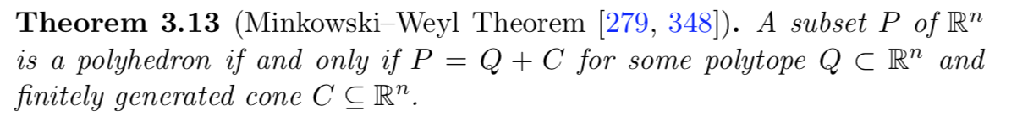
Minkowski-Weyl: From cones to polyhedra
Given:
Prove that:

Slide 13
Faces and Facets
F is a
Face of P iff
Proper Face if additionally
Facet if it is a maximal (w/r to inclusion) proper face

Slide 14
Inequalities, Equalities and Redundancy
is a
Implied equality of P iff
Facet defining for P iff
Redundant for P and iff
is a minimal representation of P iff
And no is redundant for P and L

Slide 15
Example
Implied equations?
Facet defining inequalities?
Redundant inequalities?
Minimal representation?

Slide 16
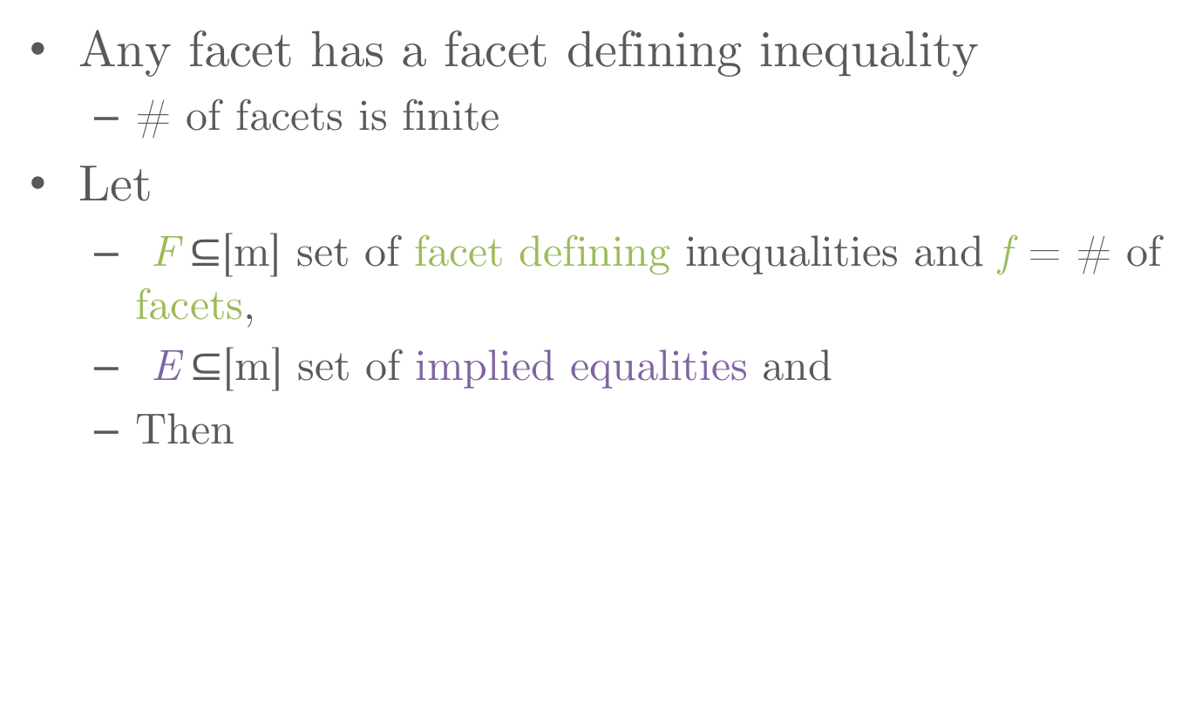
Facets and Minimal Representations
Any facet has a facet defining inequality
# of facets is finite
Let
F$⊆$[m] set of facet defining inequalities and f = # of facets,
E$⊆$[m] set of implied equalities and
Then

Slide 17
Example: Minimal Representation

Slide 18
Equalities, Inequalities and Polyhedral.jl
julia> @variable(model, x[1:2]);
julia> @constraint(model, x[2]<=0);
julia> @constraint(model, -x[2]<=0);
julia> @constraint(model, x[1]<=1);
julia> @constraint(model, -x[1]-x[2]<=0);
julia> @constraint(model, -x[1]+x[2]<=0);
julia> @constraint(model, -x[1]<=0);
julia> poly = polyhedron(model, CDDLibrary(:exact));
julia> simpleh = SimpleHRepresentation(poly);
julia> @variable(model2,x[1:2]);
julia> @constraint(model2,convert.(Int64,simpleh.A)*x .<= convert.(Int64,simpleh.b))…
x[2] ≤ 0
-x[2] ≤ 0
x[1] ≤ 1
-x[1] - x[2] ≤ 0
-x[1] + x[2] ≤ 0
-x[1] ≤ 0
julia> for eq in eqs(poly)
println(dot(convert.(Int64,eq.a),x), " == ", convert.(Int64,eq.β))
end
julia> for ineq in ineqs(poly)
println(dot(convert.(Int64,ineq.a),x), " <= ", convert.(Int64,ineq.β))
end
x[2] <= 0
-x[2] <= 0
x[1] <= 1
-x[1] - x[2] <= 0
-x[1] + x[2] <= 0
-x[1] <= 0

Slide 19
Equalities, Inequalities and Polyhedral.jl
julia> @variable(model, x[1:2]);
julia> @constraint(model, x[2]<=0);
julia> @constraint(model, -x[2]<=0);
julia> @constraint(model, x[1]<=1);
julia> @constraint(model, -x[1]-x[2]<=0);
julia> @constraint(model, -x[1]+x[2]<=0);
julia> @constraint(model, -x[1]<=0);
julia> poly = polyhedron(model, CDDLibrary(:exact));
julia> removehredundancy!(poly);
julia> simpleh = SimpleHRepresentation(poly);
julia> @variable(model2,x[1:2]);
julia> @constraint(model2,convert.(Int64,simpleh.A)*x .<= convert.(Int64,simpleh.b))…
x[2] ≤ 0
x[1] ≤ 1
-x[1] ≤ 0
julia> for eq in eqs(poly)
println(dot(convert.(Int64,eq.a),x), " == ", convert.(Int64,eq.β))
end
x[2] == 0
julia> for ineq in ineqs(poly)
println(dot(convert.(Int64,ineq.a),x), " <= ", convert.(Int64,ineq.β))
end
x[1] <= 1
-x[1] <= 0

Slide 20
Linear Transformations and Projections
Then
In particular let
Then
✓
✗
✓

Slide 21
Farkas Lemma
Version 1:
Version 2: is empty iff there exists
such that
(P nonempty)

Slide 22
Constructing the Projection of a Polyhedron
Then
Exercise: Prove it!
Sanity check: When , what is ?
Can also explicitly compute projections using Fourier-Motzkin elimination

Slide 23
Good MIP formulations

Slide 24
Basic Branch-and-Bound
(1) FRAC
z = 1.71
(2) INT
z = 0
(3) FRAC
z = 1.5
(4) INT
z = 1
(5) INF
Linear Programming (LP) Relaxation

Slide 25
“Stronger Formulations” = Faster Solves ?
(1) FRAC
z = 1.32
(2) INT
z = 0
(3) INT
z = 1

Slide 26
“Stronger Formulations” = Faster Solves ?
(1) INT
z = 1

Slide 27
Strongest Formulation = “Integral” or “Ideal”
✗
✓
✓
✓
✓
✓
“Integral” or “Ideal” formulation:
All extreme points or basic feasible solutions of LP relaxation are “integral” (satisfy integer constraint)
Optimizing a linear function = Solve LP

Slide 28
(Linear) Mixed Integer Programming Formulation
Let
P_{I} is a MIP formulation of S iff
x = original integer and continuous variables
w = auxiliary integer and continuous variables
A formulation is integral or ideal iff

Slide 29
Advantage of Integral Formulations
If P_{I} is a formulation of S then:
If P_{I} is an ideal formulation of S then:
In practice, S is one of many constraints:
Ideal (or strong) formulations tend to be more effective

Slide 30
Example: Piecewise Linear Network Flow
Network flow or transportation problem
Economies of scale for transportation costs

Slide 31
Constructing a MIP Formulation
MIP Formulation

Slide 32
Strong, but not Necessarily Ideal
Ideal for each i
Not necessarily ideal for complete problem

Slide 33
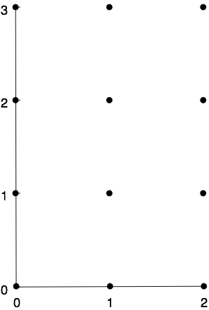
Example
Pure Integer

Slide 34
Mixed 0-1 Formulations
Modeling Finite Alternatives = Unions of Polyhedra
Bounded or unbounded polyhedra, but bounded for now

Slide 35
Graph of a Piecewise Linear Function
S₂
S₃
S₁
S_{i}

Slide 36
Very Bad Formulation for PWL Function : Big-M
Not Ideal!
S₂
S₃
S₁

Slide 37
“Better” Formulation : Convex Combination (CC)
“Stronger” than Big-M, but still not ideal
S₂
S₃
S₁

Slide 38
“Relatively” strong = “Convex Hull” or “Sharp”
S
Not integral, but LP relaxation gives convex hull

Slide 39
Sharp Formulations
A MIP formulation P_{I} of S is sharp or convex hull iff
If P_{I} is a sharp formulation of S then:
CC is a sharp formulation for piecewise linear functions, but Big-M is not sharp.
Exercise: Show for x=2 and

Slide 40
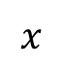
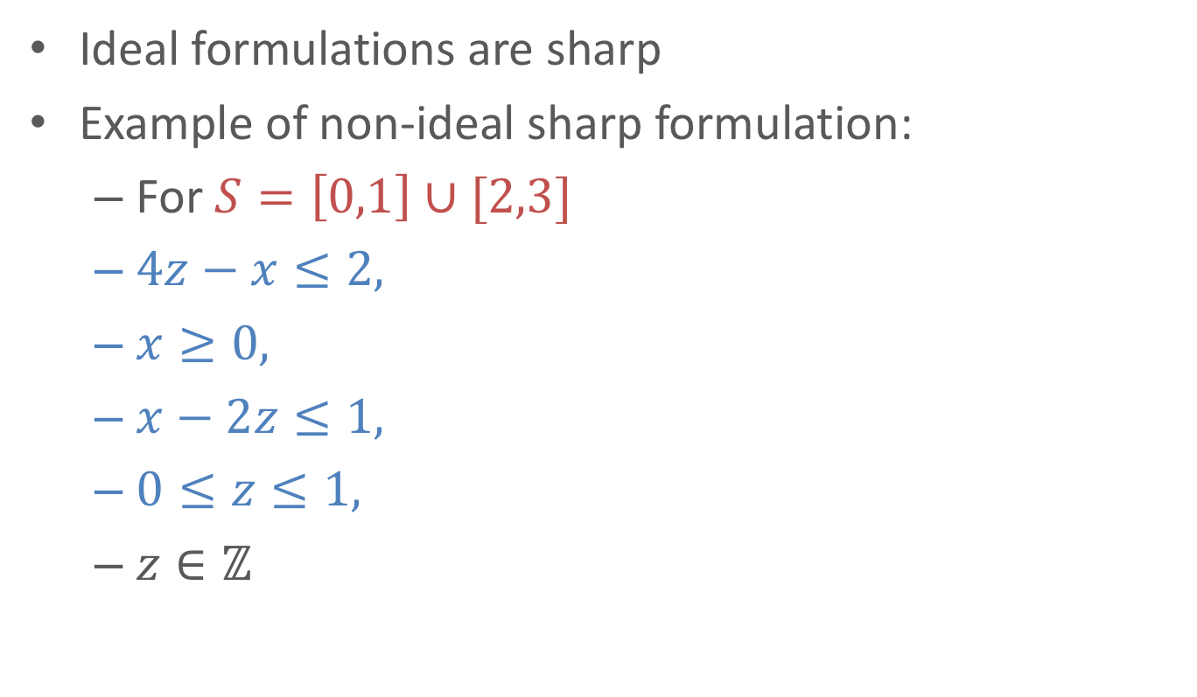
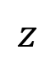
Ideal and Sharp Formulations
Ideal formulations are sharp
Example of non-ideal sharp formulation:
For $S=\left[0,1\right]∪[2,3]$
$4z−x≤2,$
$x≥0,$
$x−2z≤1,$
$0≤z≤1,$
$z∈ℤ$
$$z$$
1
½
0
$$x$$
0 1 2 3

Slide 41
Remember: CC is not Ideal

Slide 42
The power of auxiliary variables

Slide 43
Needed for Small, Strong Formulations?
Exponential sized ideal formulation:
Poly-sized non-extended formulation?
Formulations with auxiliary variables are usually called extended formulations (Usually for ideal formulations)

Slide 44
Needed for Small, Strong Formulations?
Exponential sized ideal formulation:
Polynomial sized non-ideal formulation:
Formulations with auxiliary variables are usually called extended formulations (Usually for ideal formulations)

Slide 45
Needed for Small, Strong Formulations?
Exponential sized ideal formulation:
Polynomial sized non-ideal formulation:
Polynomial sized ideal formulation?
Formulations with auxiliary variables are usually called extended formulations (Usually for ideal formulations)

Slide 46
Needed for Small, Strong Formulations?
Exponential sized ideal formulation:
Polynomial sized non-ideal formulation:
Polynomial sized ideal extended formulation:
Formulations with auxiliary variables are usually called extended formulations (Usually for ideal formulations)

Slide 47
Sometimes non-ideal formulations are large
Write a MIP formulation for “Parity”:
All vectors in with an odd number of ones.

Slide 48
Sometimes non-ideal formulations are large
Write a MIP formulation for “Parity”:
All vectors in with an odd number of ones.
Modelling Trick 1: How to exclude a point
Ideal Formulation for “Parity”:
Proposition: “Every” non-extended formulation (even non-ideal) needs exponential many inequalities
Exponential number of inequalities!

Slide 49
Smaller Formulation with “Auxiliary” Variables
Alternative formulation:
However formulation is not ideal:
Let:
Then:
Small ideal formulation for Parity: In a few slides

Slide 50
Key to Size Advantage of Auxiliary Variables
Projecting a polyhedron can exponentially increase the number of facets.

Slide 51
Limits of Projection
Then
If Q has m inequalities
what is the largest # of facets of ?
= # extreme rays of C
Only polynomial increase if p is fixed

Slide 52
What About Matching?
General maximum weight matching:
1
4
2
5
3
There is no poly-size ideal extended formulation for general matching (Rothvoss ’13)

Slide 53
Combinatorial disjunctive constraints

Slide 54
Graph of a Piecewise Linear Function
S₂
S₃
S₁
S_{i}

Slide 55
Mixed 0-1 Formulations
Modeling Finite Alternatives = Unions of Polyhedra
Bounded or unbounded polyhedra, but bounded for now

Slide 56
Two Types of Bounded Polyhedra (Polytopes)

Slide 57

Example of an $ℋ$-based Formulation
Data = Linear inequalities mixed with formulation
S₂
S₃
S₁

Slide 58

Example of an $𝒱$-based Formulation
3
2
S₂
1
S₃
S₁
4
Data = vertices
in linear transformation separate from formulation

Slide 59
Linear Transformation for
Dependent on specific data from polytopes
Purely Combinatorial

Slide 60
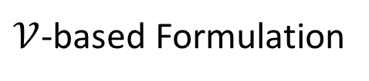
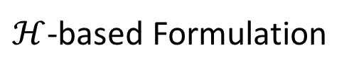
Constructing Ideal Formulations
Add inequalities to fix non-ideal formulation
$ℋ$-based Formulation
$𝒱$-based Formulation
Purely Combinatorial / Data Independent = Often Simpler

Slide 61
Fixing Big-M Formulation
S₂
S₃
S₁
How to construct convex hull of infinite # of feasible solutions to Big-M:
Take convex hull of

Slide 62
Fixing CC Formulation
S₂
S₃
S₁
Take convex hull of

Slide 63
Extended Formulation for Unions of Polytopes
rational polytopes and
then an ideal formulation for S is
Exercise: Why is this formulation valid?

Slide 64
Ideal Formulation for PWL Functions
MC Formulation:
S₂
S₃
S₁

Slide 65
Extended Formulations for
Both formulations are ideal and use copies of variables

Slide 66
DCC Formulation:
3
2
1
4
Much more to come…

Slide 67
Exercise: Small ideal formulation for “Parity”
Write a polynomial-sized ideal MIP formulation for “Parity”:
All vectors in with an even number of ones.

Slide 68
Exercise: Small ideal formulation for “Parity”
Write a polynomial-sized ideal MIP formulation for “Parity”:
All vectors in with an even number of ones.

Slide 69
More On Formulations

Slide 70
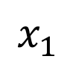
Better Multi-Big-M $ℋ$-based Formulation
Usually not ideal, but often stronger than standard Big-M

Slide 71
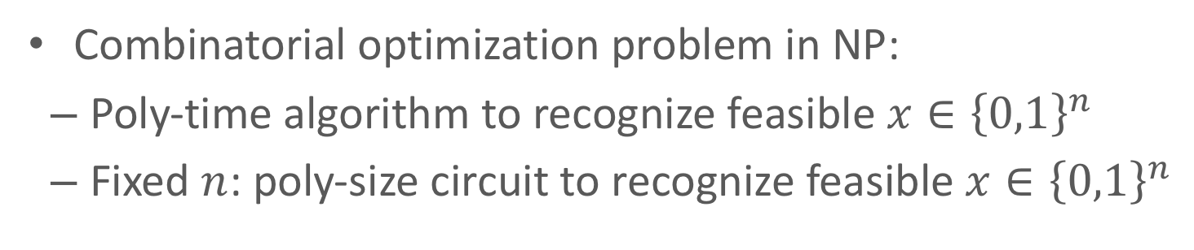
General $𝒱$-based CC-Like Formulation
Usually not ideal, but “relatively” strong

Slide 72
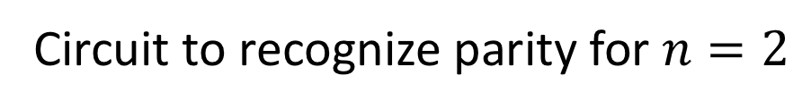
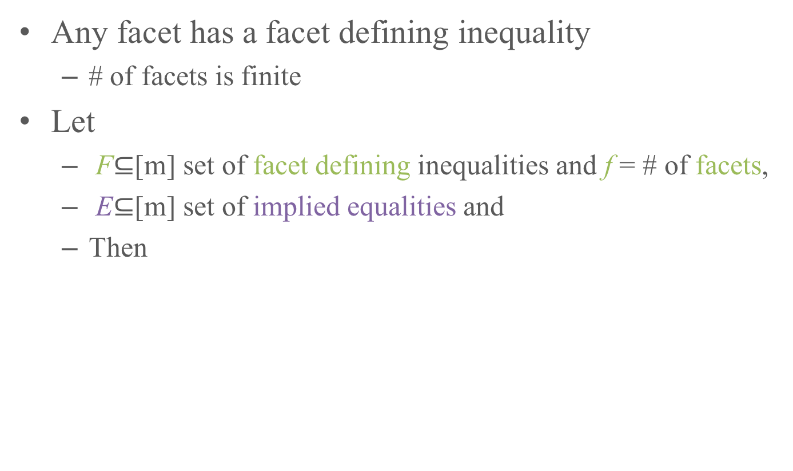
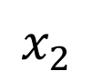
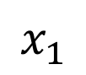
Universal Polynomial-Size Extended Formulation
Combinatorial optimization problem in NP:
Poly-time algorithm to recognize feasible $x∈{\left\{0,1\right\}}^{n}$
Fixed $n$: poly-size circuit to recognize feasible $x∈{\left\{0,1\right\}}^{n}$
$$x_{1}$$
$$1$$
$$x_{2}$$
Circuit to recognize parity for $n=2$

Slide 73
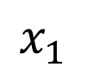

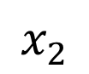
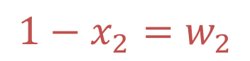
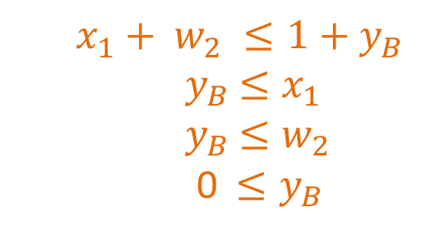
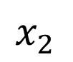
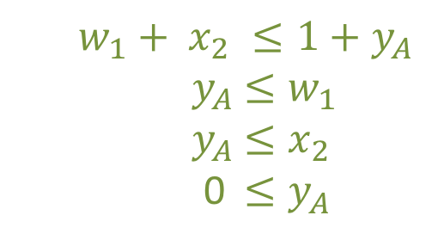
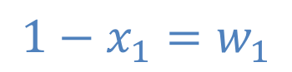
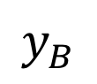

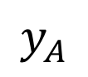
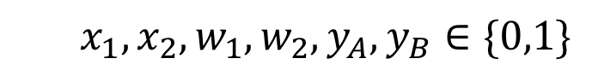
Universal Polynomial-Size Extended Formulation
$$w_{1}+ x_{2} ≤1+y_{A}$$
$${ y}_{A} ≤w_{1}$$
$${ y}_{A} ≤x_{2}$$
0$≤y_{A}$
From circuit to MIP:
$$1−x_{1}=w_{1}$$
$$x_{1}$$
$$y_{A}$$
$$x_{2}$$
$$x_{1}$$
$$1$$
$$1≤y_{A}+y_{B}$$
$$x_{1}+ w_{2} ≤1+y_{B}$$
$${ y}_{B} ≤x_{1}$$
$${ y}_{B} ≤w_{2}$$
0$≤y_{B}$
$$x_{2}$$
$$y_{B}$$
$$1−x_{2}=w_{2}$$
$$x_{1}, x_{2}, w_{1},w_{2},y_{A}, y_{B}∈\{0,1\}$$

Slide 74
Is Universal Formulation Ideal?
$$w_{1}+ x_{2} ≤1+y_{A}$$
$${ y}_{A} ≤w_{1}$$
$${ y}_{A} ≤x_{2}$$
0$≤y_{A}$
From circuit to MIP:
$$1−x_{1}=w_{1}$$
$$x_{1}$$
$$y_{A}$$
$$x_{2}$$
$$x_{1}$$
$$1$$
$$1≤y_{A}+y_{B}$$
$$x_{1}+ w_{2} ≤1+y_{B}$$
$${ y}_{B} ≤x_{1}$$
$${ y}_{B} ≤w_{2}$$
0$≤y_{B}$
$$x_{2}$$
$$y_{B}$$
$$1−x_{2}=w_{2}$$
$$x_{1}, x_{2}, w_{1},w_{2},y_{A}, y_{B}∈\{0,1\}$$
All 5 pieces of the formulation are ideal!

Slide 75
Universal 2-Parity Formulation is Not Ideal
julia> model = Model(); @variable(model,x[1:2],Bin); @variable(model,w[1:2],Bin); @variable(model,y[["A","B"]],Bin);
julia> @constraint(model,[i=1:2], 1-x[i]==w[i]);
julia> @constraint(model,w[1]+x[2]<=1+y["A"]);
julia> @constraint(model,x[1]+w[2]<=1+y["B"]);
julia> @constraint(model,y["A"]<=w[1]);
julia> @constraint(model,y["A"]<=x[2]);
julia> @constraint(model,y["B"]<=w[2]);
julia> @constraint(model,y["B"]<=x[1]);
julia> poly = polyhedron(model, CDDLibrary(:exact));
julia> SimpleVRepresentation(poly); removevredundancy!(poly); SimpleVRepresentation(poly);
V-representation
begin
6 7 rational
1 1//1 0//1 0//1 1//1 0//1 1//1
1 1//2 1//2 1//2 1//2 1//2 0//1
1 1//2 1//2 1//2 1//2 0//1 1//2
1 0//1 0//1 1//1 1//1 0//1 0//1
1 0//1 1//1 1//1 0//1 1//1 0//1
1 1//1 1//1 0//1 0//1 0//1 0//1
end
Intersecting formulations does not necessarily preserve their strength

